Slide 1

Guided Project – 1
Housing Prices increase over a decade in London boroughs

Slide 2
What did you find? Which borough is the most expensive? Any other interesting trends?
This exercise led to a conclusion about the highest and the lowest rise in housing prices among the boroughs of London.
Hackney is the most expensive borough after two decades.
Hackney is the only borough with a ratio of 6 while the next eight boroughs had ratios in 5. All the boroughs after eighth position had ratios ranging in 4 except the last borough - Hounslow which had a ratio in 3 to become the least expensive borough.

Slide 3
How did you arrive at your conclusion?
A specific data frame that had the boroughs and respective ratio of increase in price during 1998 and 2018 was formed.
A bar chart was built for visual representation to analyse the expensive boroughs.

Slide 4
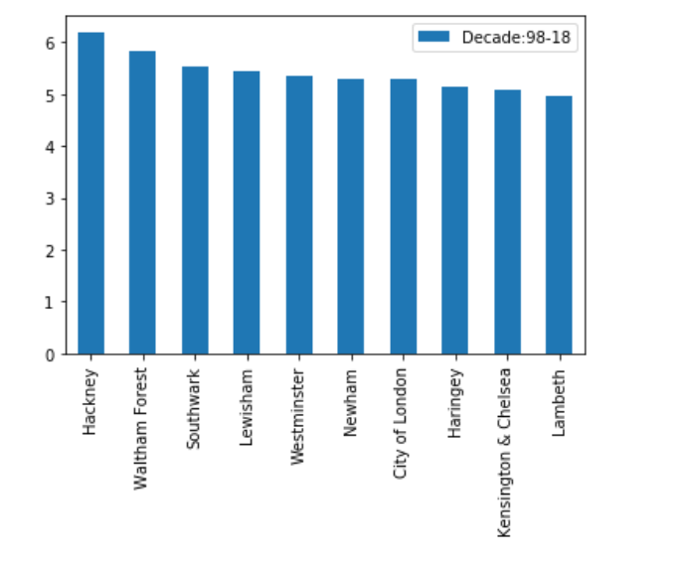
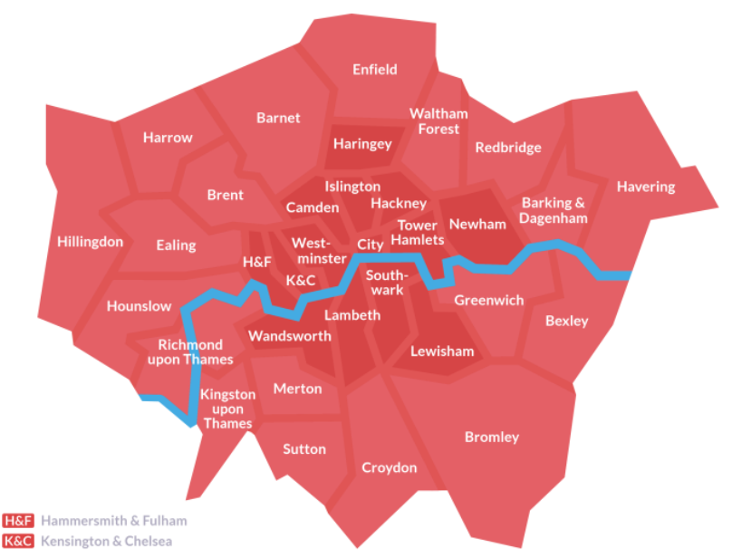

Slide 5
What were the main challenges you encountered? How did you overcome them? What could you not overcome?
The major challenge that I faced was cleaning the dataset. It had several possible methods but finding out which way would suit was a challenge for me.
I had discussion with multiple people (Including mentor) and then starting building the code step by step .
I could not overcome the problem of referring syntax online/elsewhere. I will need to practice more problems to make myself familiar with its use.

Slide 6
Is there anything you’d like to investigate deeper?
In the top 10 expensive boroughs, Waltham forest is the only borough that is edging the boundary of London and away from the city. Despite away from the city or the Thames river, it managed to get placed in the 2nd position.

